Slide 1

Advanced Application Programming in Java Park Smart
Vinay Kumar Mule(700718629)
Maddipudi Harsha(700718045)
Instructor: Prof. Sunae Shin

Slide 2
Background
With the increase in automobile usage, the problems associated with parking and its management has increased by many fold. Today, in many parts of the world, people in all the metro cities are facing issues related to parking.
public places such as malls, multiplex system, hospitals, offices, market areas there is a crucial problem of vehicle parking. The vehicle parking area has many lanes/slots for car parking. So to park a vehicle one has to look for all the lanes. Moreover this involves a lot of manual labour and investment.

Slide 3
Existing System
In order to cope with the previously mentioned parking and it’s vehicle management related issues, many rely on manpower based ledging system and human assisted parking at all the levels of parking areas.
The major concerns with the above mentioned system is that it requires a lot of man hours just to handle a few vehicles in a day. Moreover security can be a prime concern where data of all the vehicles are prone to risk if the parking staff is compromised.
Efficiency in utilising the parking space is also major drawback in the existing parking systems.

Slide 4
Functionalities
SuperAdmin Module
Login
Dashboard
Client/Mall registration
Add/modify/delete - client/mall users
Map Client /Mall to users
Reports
ClientAdmin Module
Login module
Central Dashboard
Enable/disable parking levels depending upon the utilization
Pricing according to the vehicle class
Vehicle registration
Vehicle checkin
Vehicle checkout
Billing
Void ticketing for staff

Slide 5
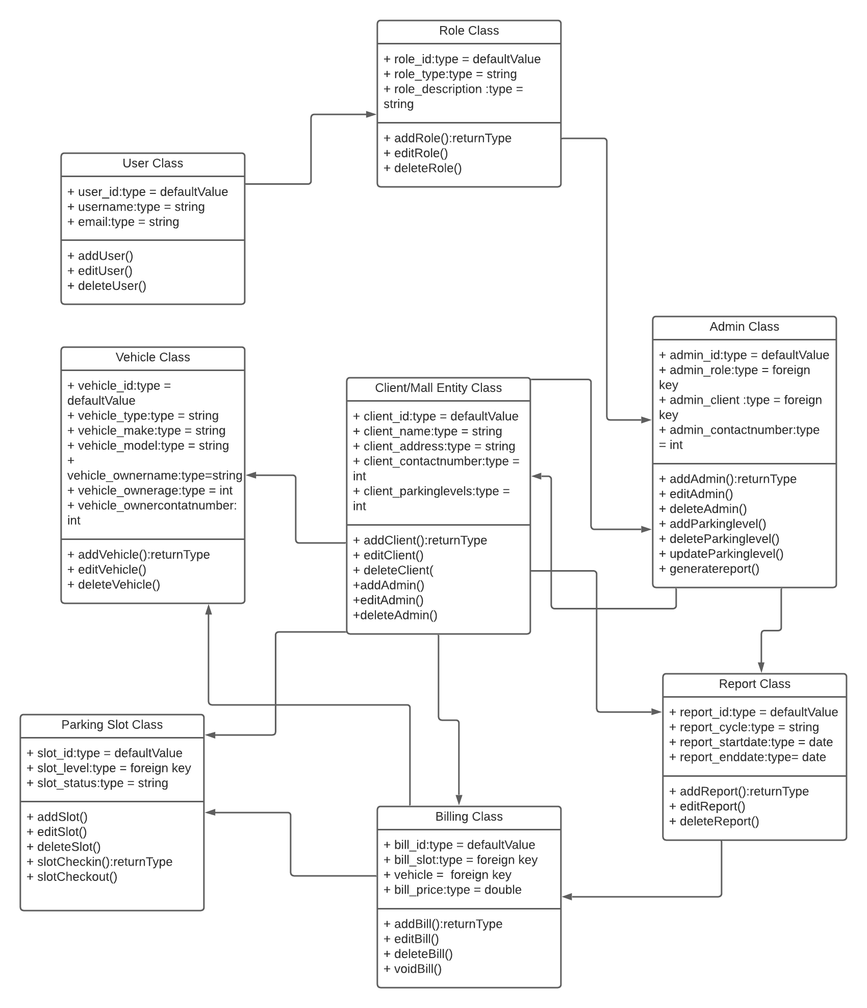
Class Diagram

Slide 6
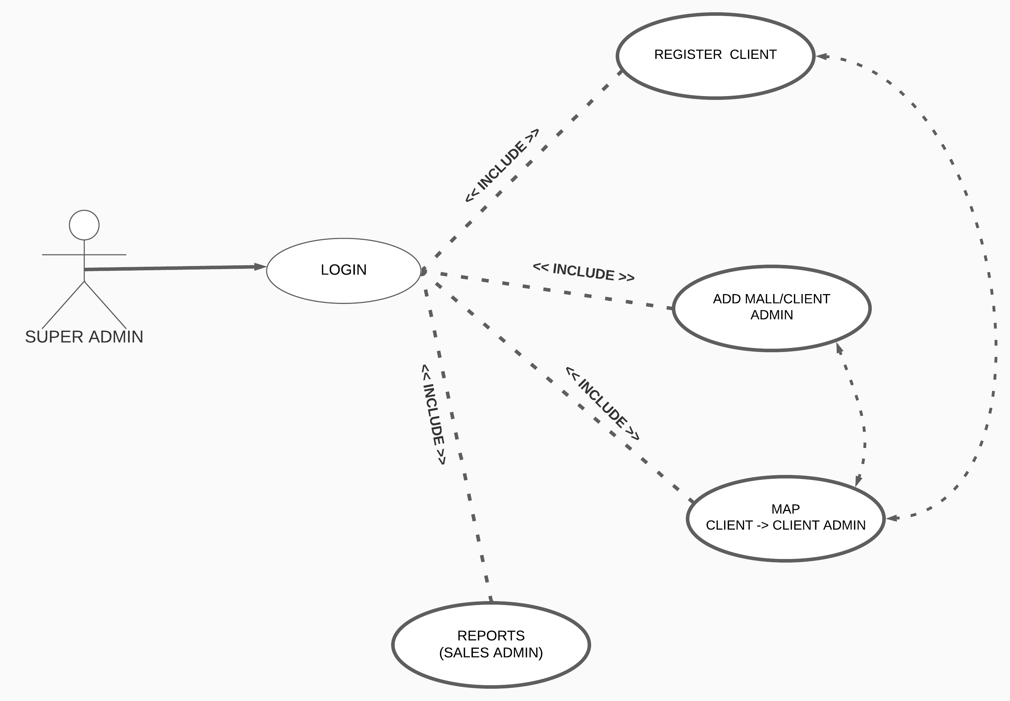
Usecase Diagram For Super Admin

Slide 7
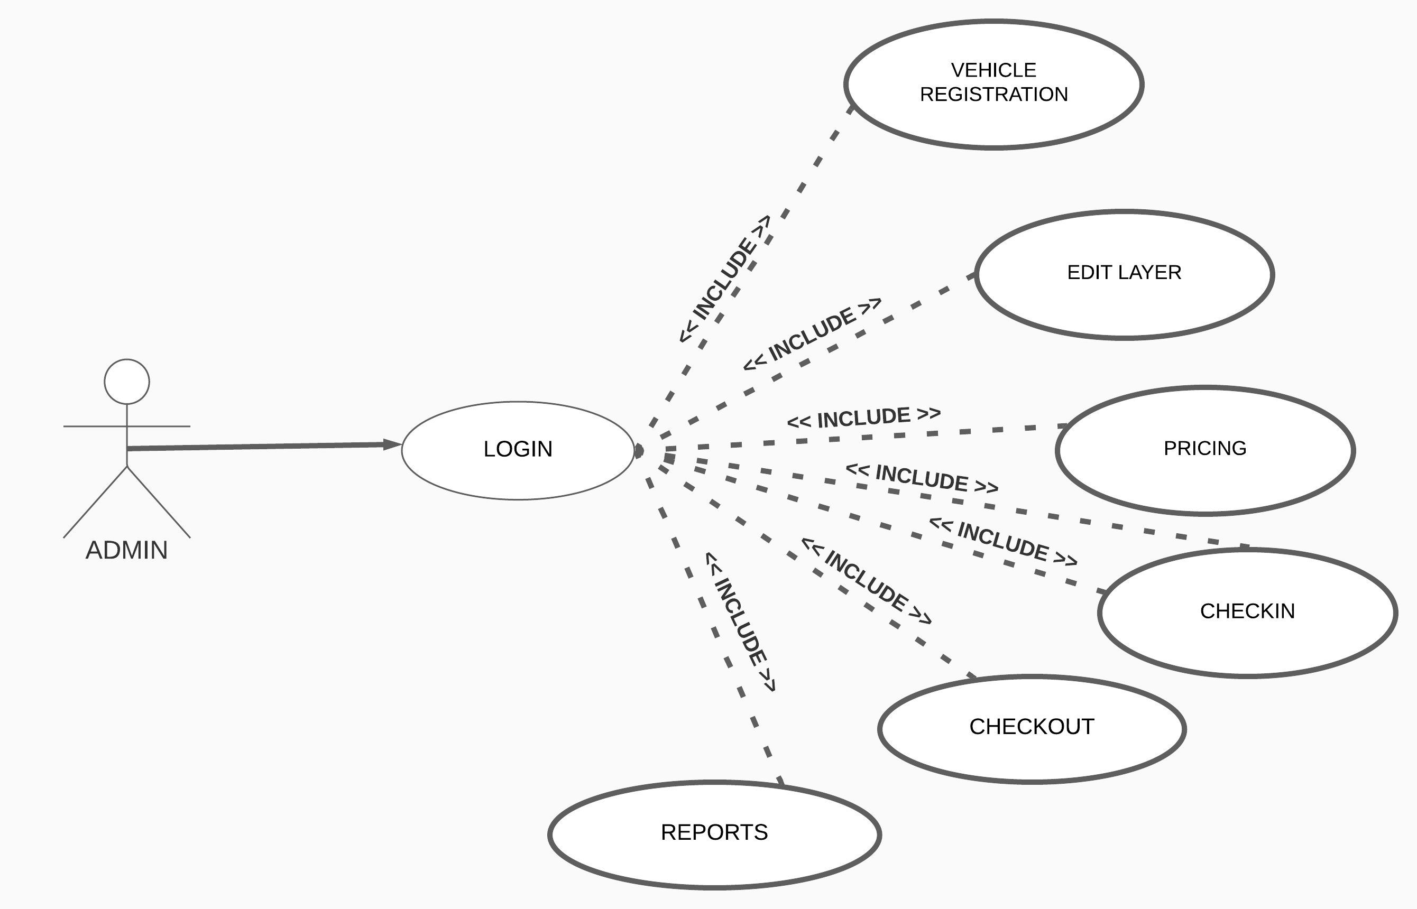
Usecase Diagram for Admin

Slide 8
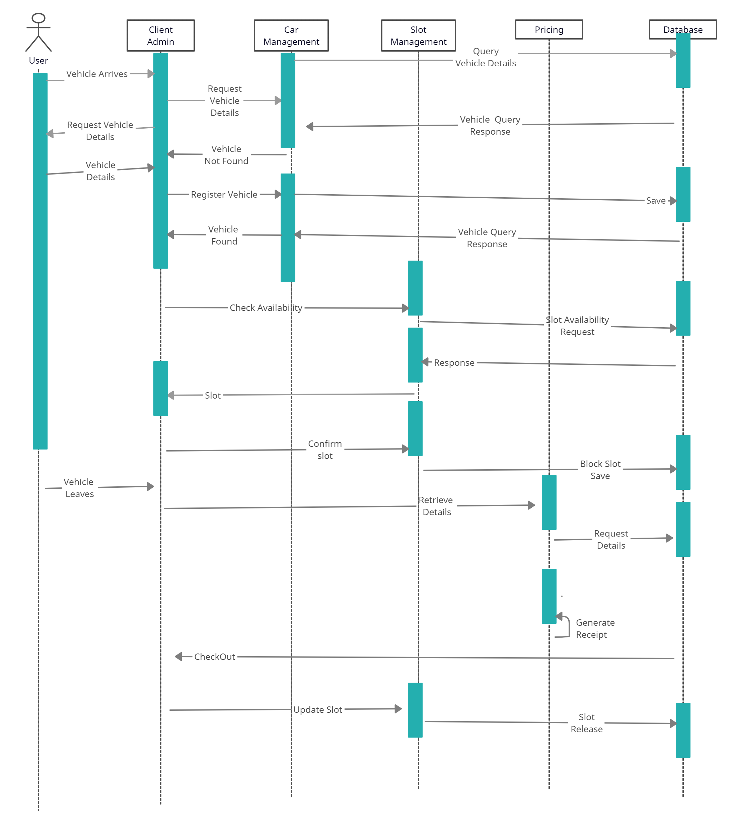
Sequence Diagram

Slide 9
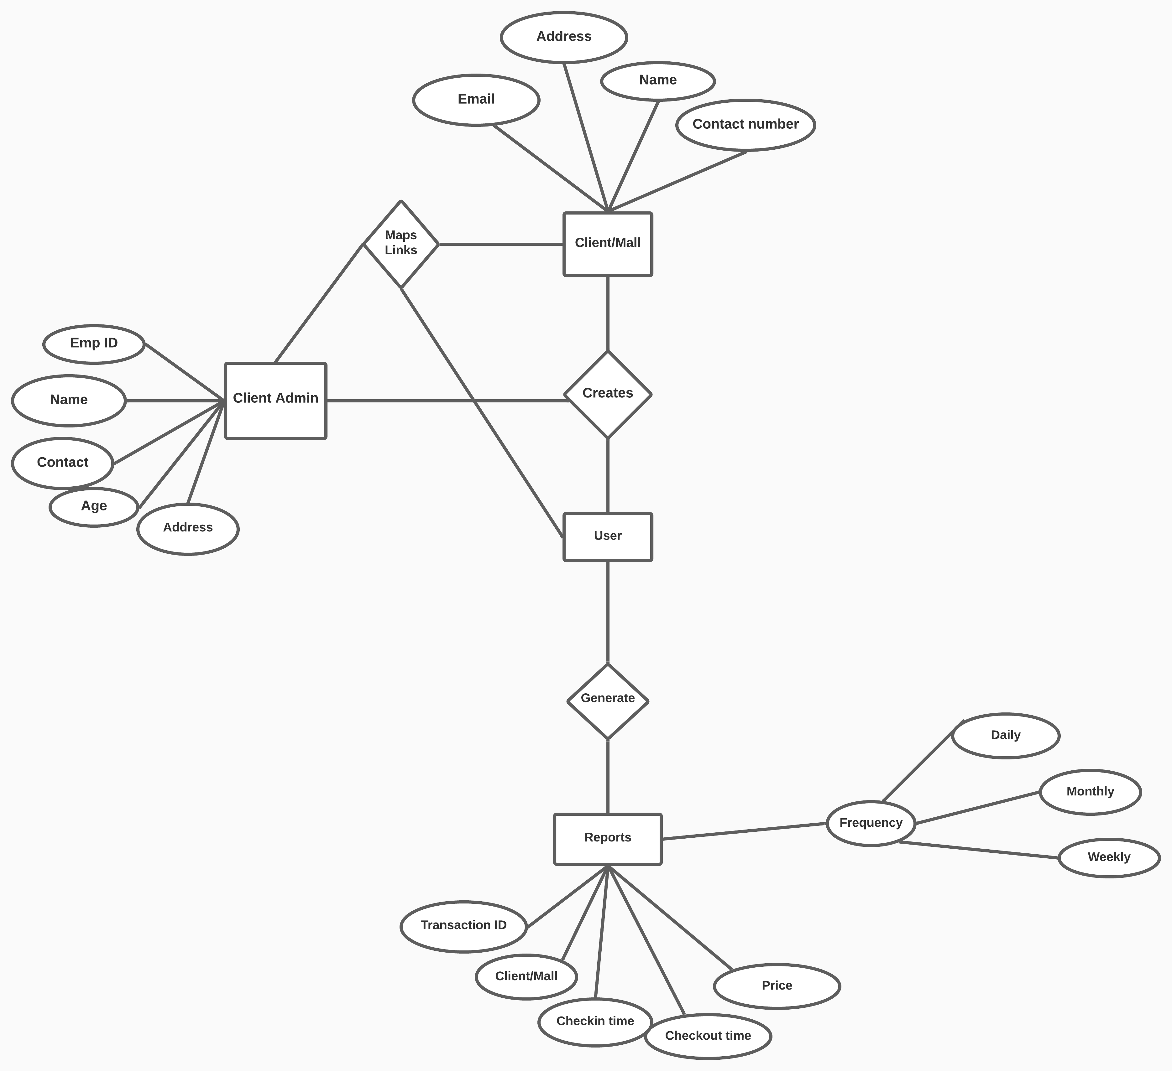
E-R Diagram for SuperAdmin

Slide 10
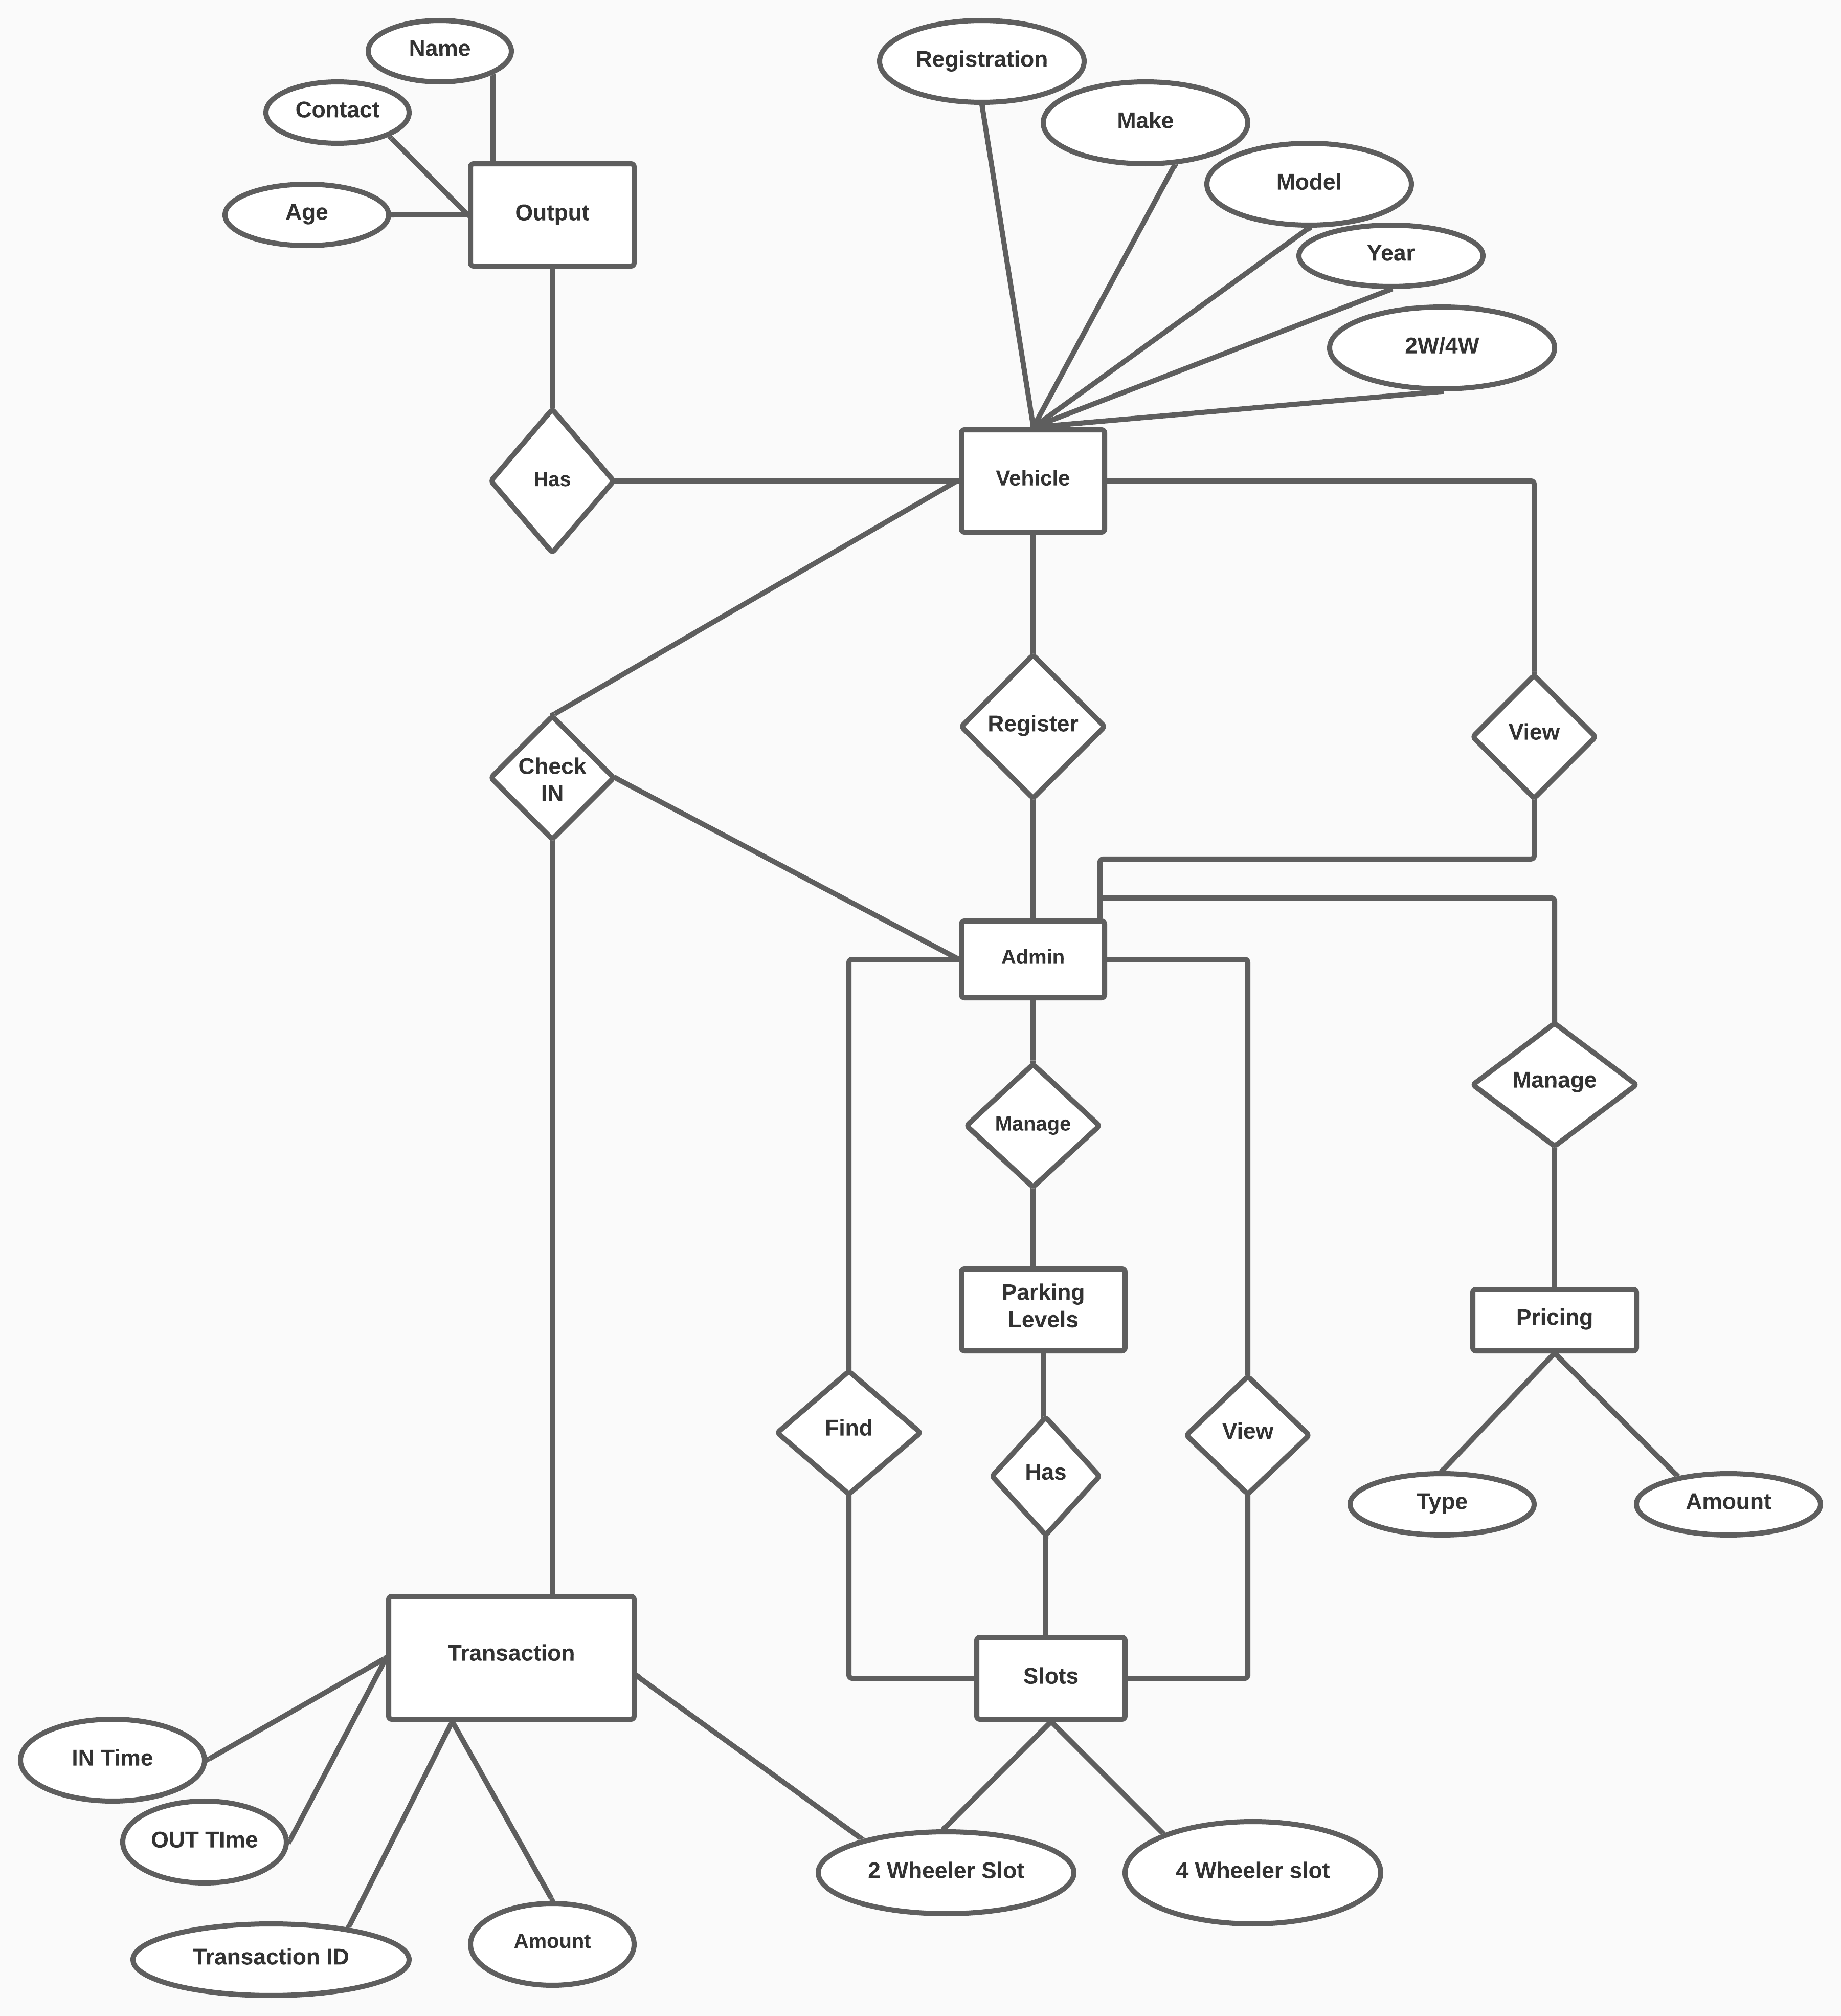
E-R Diagram for Admin

Slide 11
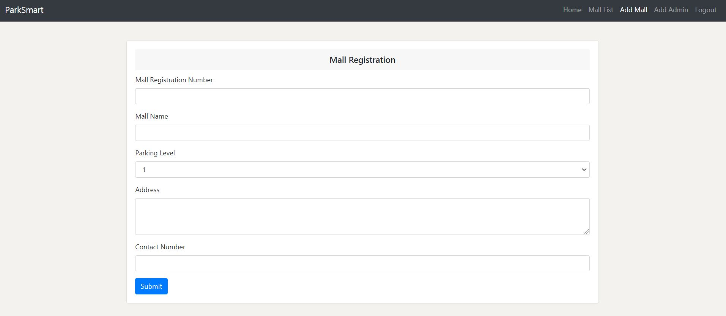
Screenshot of Adding Mall

Slide 12
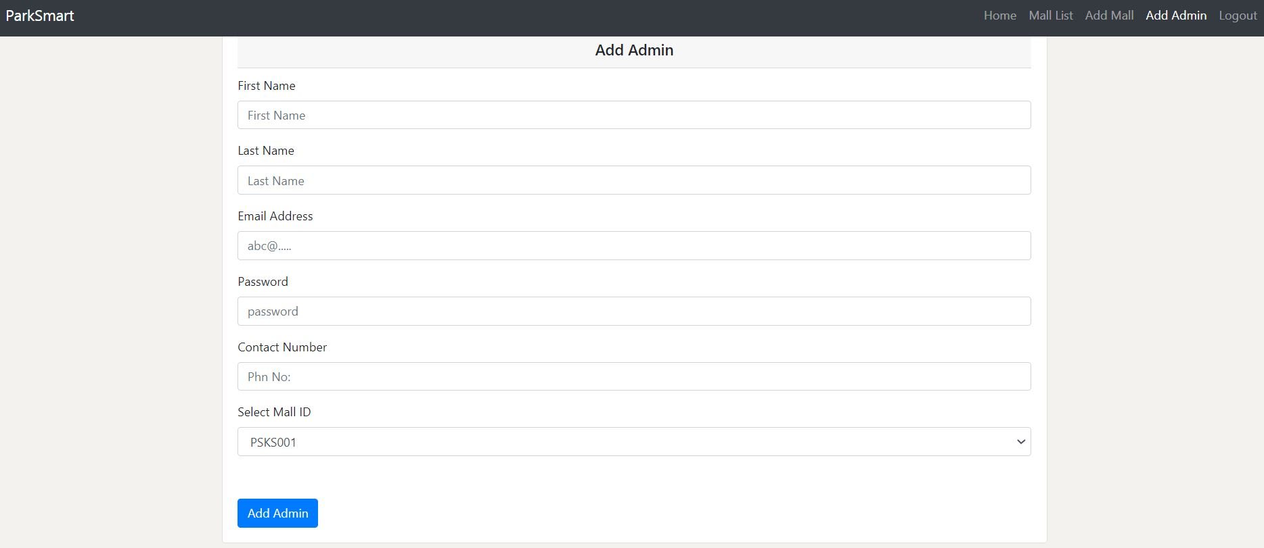
Screenshot of Adding Admin for a mall

Slide 13
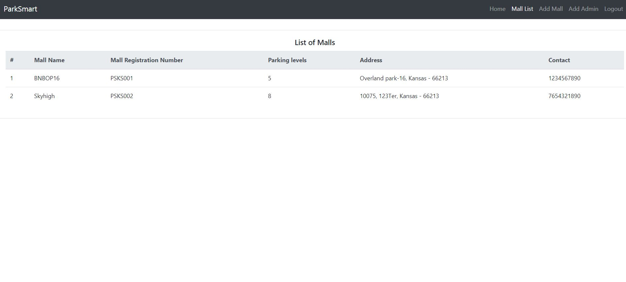
Screenshot of list of malls

Slide 14
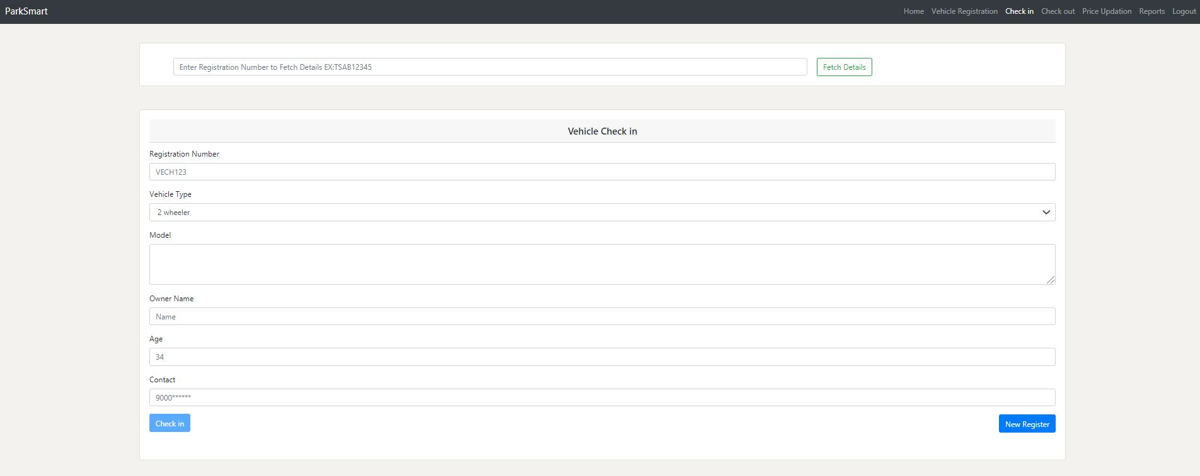
Screenshot of checking in Vehicle

Slide 15
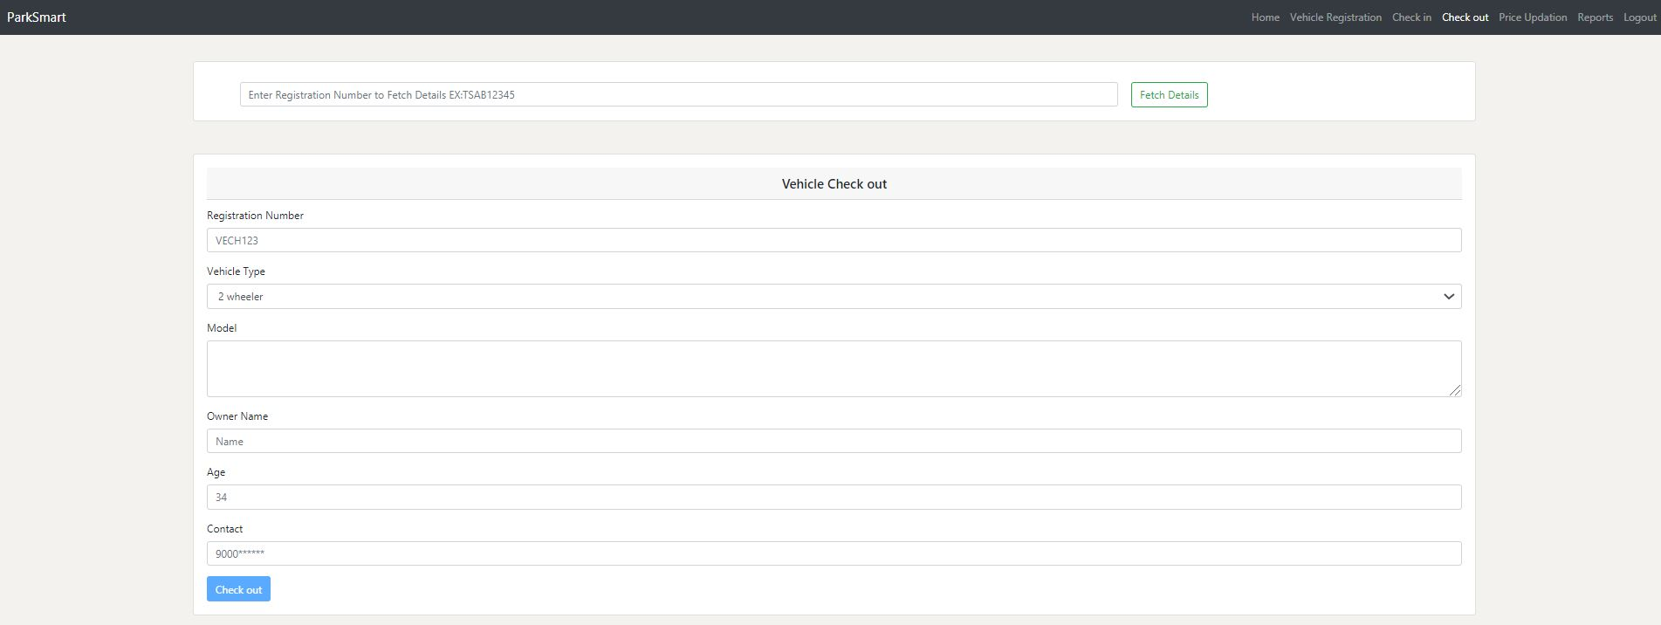
Screenshot of Checkout Page

Slide 16
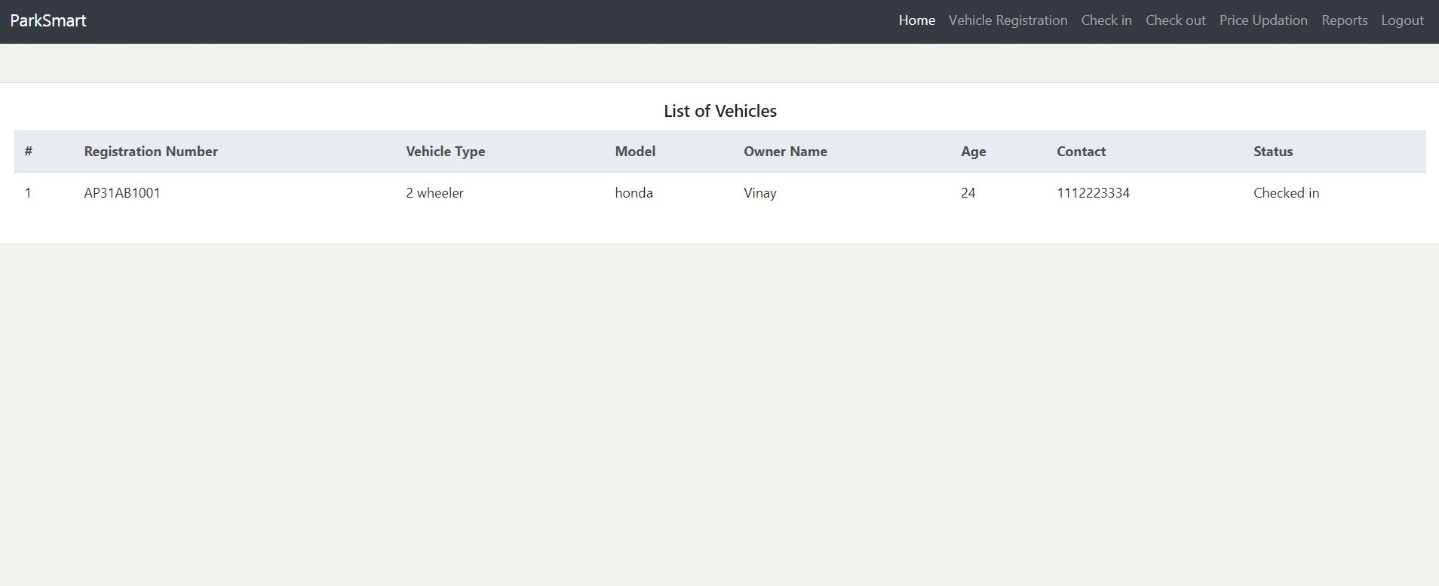
Screenshot of List of vehicles

Slide 17
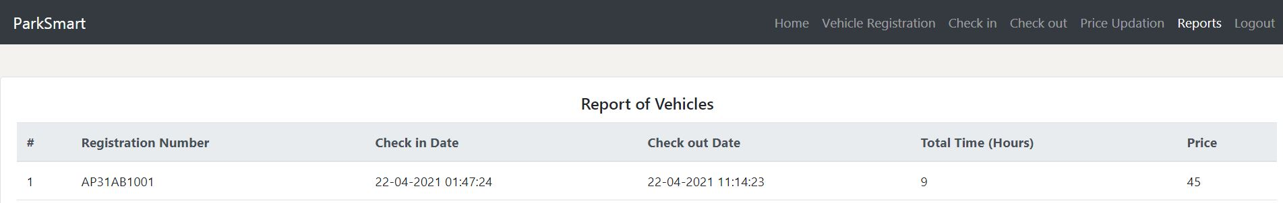
Screenshot of Report Generation

Slide 18
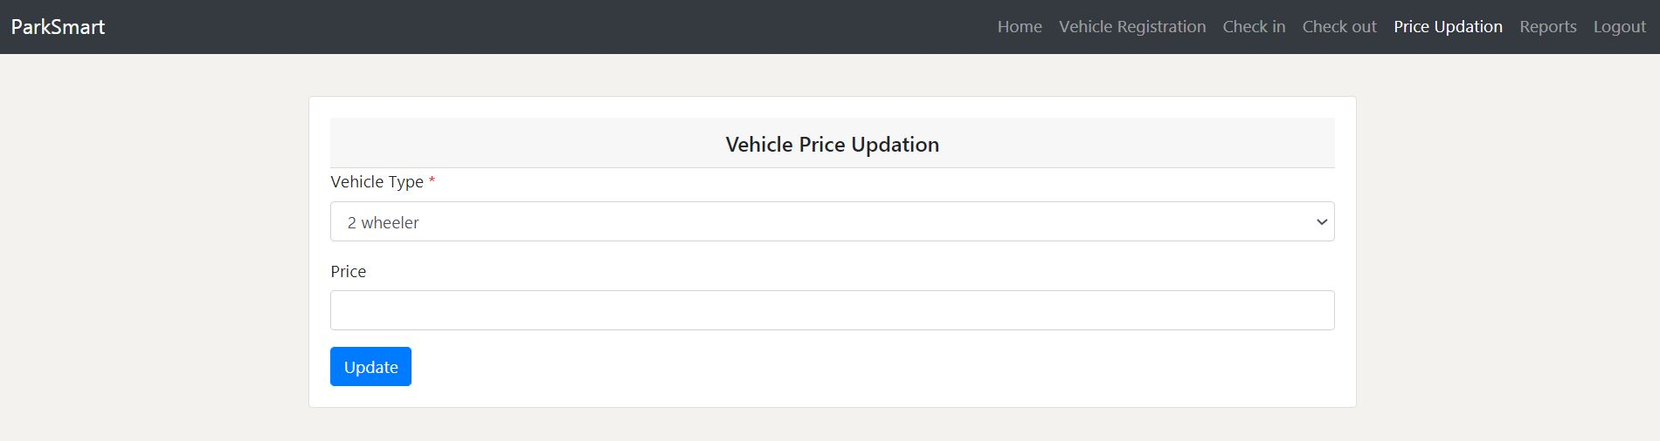
Screenshot of Price Updation

Slide 19

Thank You

